Slide 1
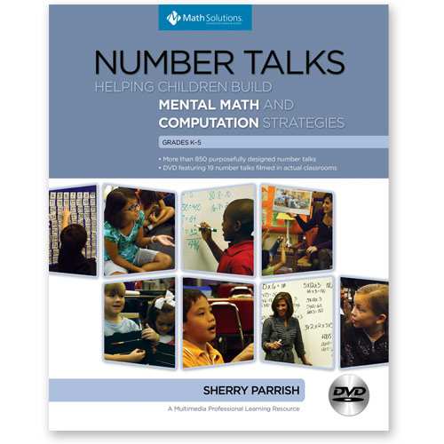
EERTI
Continuing Group

Slide 2
Elizabeth Jean Bingham
Central Elementary
Elizabeth.bingham@knox.kyschools.us

Slide 3

Key Components of Number Talks
1. Classroom environment is the key!!
build a cohesive math community
a risk-free environment
designate a place
the students sit altogether on the floor
a place to write…. in Number Talks the teacher does the recording

Slide 4
T.3 CLIP
3RD GRADE TEACHER

Slide 5
2. Classroom Discussion
computation is done mentally
provide plenty of time
use a signal such as thumbs on their chest to show they have the answer
students share their strategies and justifications with their peers

Slide 6
The benefits of Number Talks are:
students clarify their own thinking
test other strategies to see if they are logical
apply number relationships
build a repertoire of efficient strategies
learn how to talk about math

Slide 7
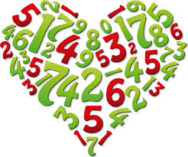
3. The Teacher's Role
The heart of Number Talks is classroom conversations.
teacher becomes the facilitator
teacher writes down all the students' answers
students "justify" their answers by sharing their strategies
While the student is explaining a strategy the teacher is recording the strategy on the board.
It is a great way to model recording strategies!

Slide 8
Teacher poses questions
students lead the conversation
By changing the question from "What answer did you get?" to "How did you solve this problem?" the teacher is able to understand how the students are making sense of mathematics.
Don't be afraid to share incorrect solutions.
Wrong answers can lead to great classroom discussion and point out misconceptions a student may have.

Slide 9
4. The Role of Mental Math
help the students focus on number relationships
help them use these relationships to solve problems
When students approach problems without paper and
pencil,
they are encouraged to rely on what they know
what they understand about the numbers
how they are interrelated.

Slide 10
CLASSROOM CLIP 5.3
16 x 35 – 5TH Grade

Slide 11
5. Purposeful Computation Problems
Careful planning before a number talk
design the problem that is "just right"
The learning target should determine the numbers and operations that are chosen.

Slide 12
HOW DOES
NUMBER TALKS
RELATE
TO
MATH

Slide 13
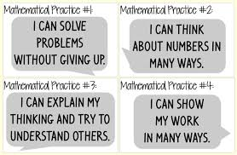
MATHEMATICAL PRACTICES 1 - 4

Slide 14
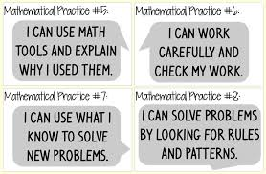
MATHEMATICAL PRACTICES 5 - 8

Slide 15
Number Talk Ideas:
Try to do every day for a small amount of time (10-15 minutes)…a few minutes often is much better than a lot of minutes every once in awhile. NO MORE THAN 15 MINUTES
Establish a routine – thumbs up when you are ready and have an answer…another finger up if you have another way to solve this problem.

Slide 16
Ask questions and let the kids do the talking!
What did you see?
How did you see it?
Did anyone see it a different way?
How did you think about that?
How did you figure it out?
What did you do next?
Why did you do that?
Did someone solve the problem a different way?
What strategies do you see being used?

Slide 17
Use different mediums…
Whiteboard
chart paper
smartboard

Slide 18
Name/label the strategies that your students talk about using…
doubles counting on
doubles+1 constant difference
decompose friendly number
make a ten doubling and halving
counting on partial product
ETC…

Slide 19
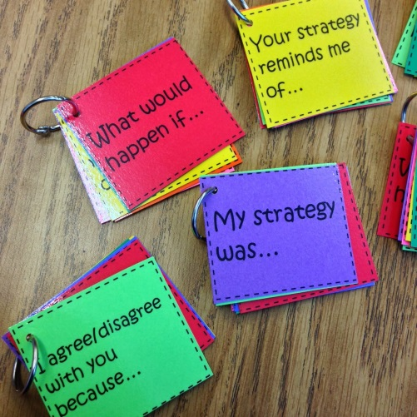
TO HELP STUDENTS GET STARTED
sentence starters…
"My strategy was..."
"I agree/disagree with you because..."
"I know a different way..."
"I hear you say that..."
"What would happen if..."

Slide 20
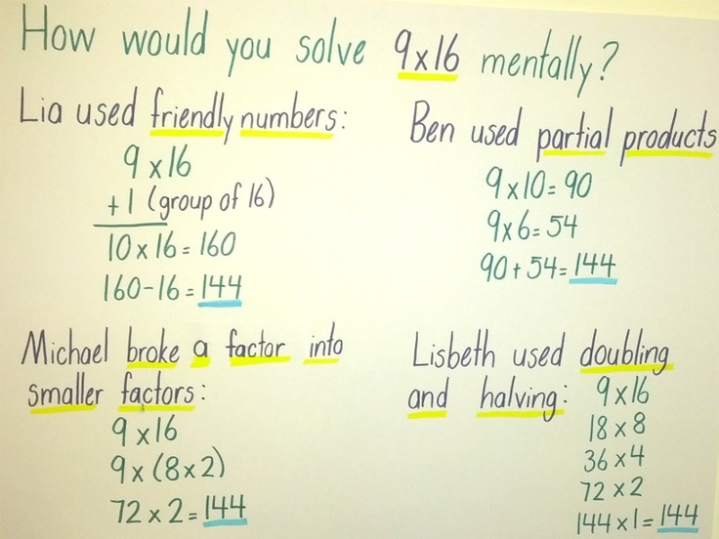
*Create a safe environment during the number talks

Slide 21
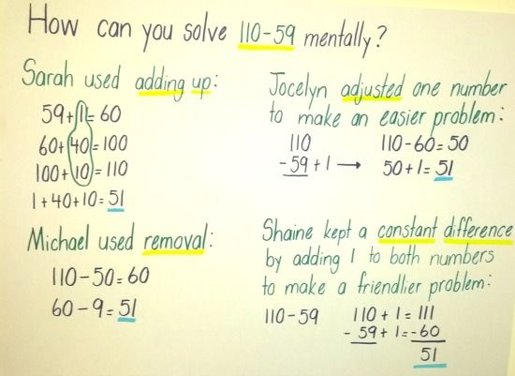

Slide 22
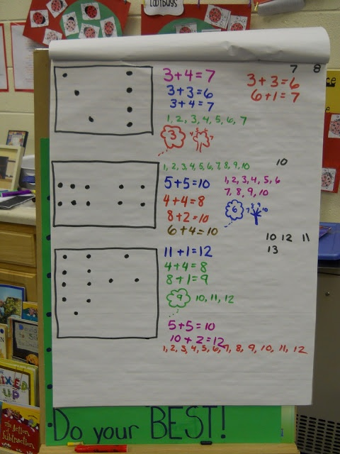

Slide 23
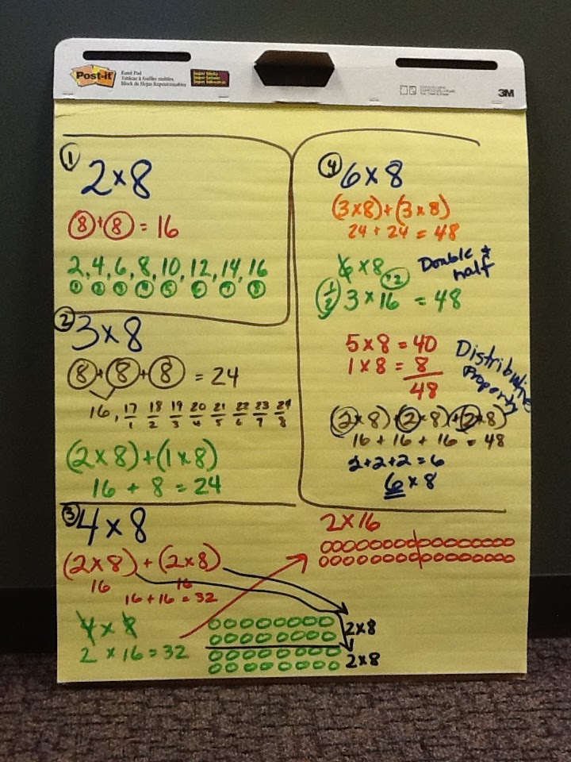

Slide 24
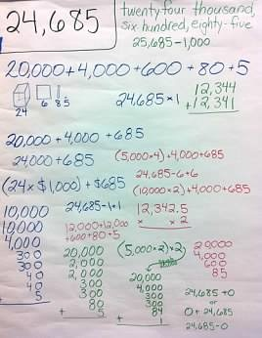

Slide 25
KINDERGARTEN CLASSROOM
K.1 CLIP KINDERGARTEN CLASSROOM

Slide 26
Questioning
For the teacher, you should see questions that are generally open and probing for meaning.
For the students, you should see encouragement student-to-student talk in small groups by helping each other clarify where they are having difficulty and focusing on making sense of the problem, not just put numbers into a formula

Slide 27
Explaining Mathematical Thinking
For the teacher, you should see a teacher asking for more than one way to solve the problem.
For the student, you should see students sharing their thinking with each other and whole class without prompting or little probing from teacher.

Slide 28
Source of Mathematical Ideas
For the teacher, you should see teachers working with student errors or letting the student’s ideas guide the direction of lesson.
For the students, you should see students relying on their own ideas or thinking. Their ideas are valued and worthwhile.

Slide 29
Responsibility for Learning
For the teacher, you should see teachers supporting students as they evaluate each other’s work or thinking.
For the students, you should see students agreeing or disagreeing with each other in order to understand

Slide 30
Is MATH TALK a waste of my time?

Slide 31
PROFESSIONAL GROWTH AND EFFECTIVENESS SYSTEM
FRAMEWORK FOR TEACHING PROFICIENCY SYSTEM
Comp. 2A: Creating an Environment of Respect and Rapport
Comp. 2B: Establishing a Culture for Learning
Comp. 2C: Managing Classroom Procedures
Comp. 2D: Managing Student Behavior
Comp. 3A: Communicating with Students
Comp. 3B: Using Questioning/Prompts and Discussion Techniques
Comp. 3C: Engaging Students in Learning
Comp. 3D: Using Assessment in Instruction

Slide 32
Five Talk Moves
1. Revoicing. (“So you’re saying that it’s an odd number?”) : When students talk about mathematics, it’s often very difficult to understand what they say.
2. Repeating: Asking Students to Restate Someone Else’s Reasoning.
(“Can you repeat what he just said in your own words?”)
3. Reasoning: Asking students to Apply Their Own Reasoning to Someone Else’s Reasoning.
(“Do you agree or disagree and why?”)

Slide 33
4. Adding on: Prompting Students for Further Participation.
(“Would someone like to add something more to this?”)
5. Waiting: Using Wait Time.
(“Take your time..we’ll wait…”)

Slide 34
NUMBER TALKS ARE…
Students TALKING about their mathematical reasoning
Students using mathematical lingo
Students proposing multiple solutions or ways of solving a problem
Students analyzing and critique the solutions and shared thought processes of their peers

Slide 35
MORE QUESTIONING
Help us understand your thinking?
Did anyone else think of this differently?
Does everyone have the same idea?
What questions do you have?
What is confusing?
What was the big idea that helped you make sense of this?
What are people still wondering?

Slide 36
NUMBER TALKS ARE…
SHORT MATH TALKS
STUDENTS TALKING
STUDENTS THINKING
STUDENTS EXPLAINING /JUSTIFYING
TEACHER WRITING
EYE OPENING
A SAFE ENVIRONMENT

Slide 37
Third Grade Classroom
3.7 Multiplication String 7 X 7

Slide 38
MAKE AND TAKE

